Slide 1


Tracking Plutchik Emotions
in Series of TV Shows
Students: Rotem Shitrit
Elia Amar
Supervisor: M.Sc. Julia Sheidin
March 29, 2019
Notes:
Good morning everyone.
My name is Rotem Shitrit, and this is my partner Elia Amar.
I want to introduce you our project about
Tracking Plutchik Emotions in Series of TV Shows
so what is emotion at all?

Slide 2
Emotions
Notes:
Emotion is the ability to express a state of mind or body.
It may be expressed in certain patterns of thought and behavior.
There are several theories about emotions.
one of the most popular of them is Pluchick theory.

Slide 3
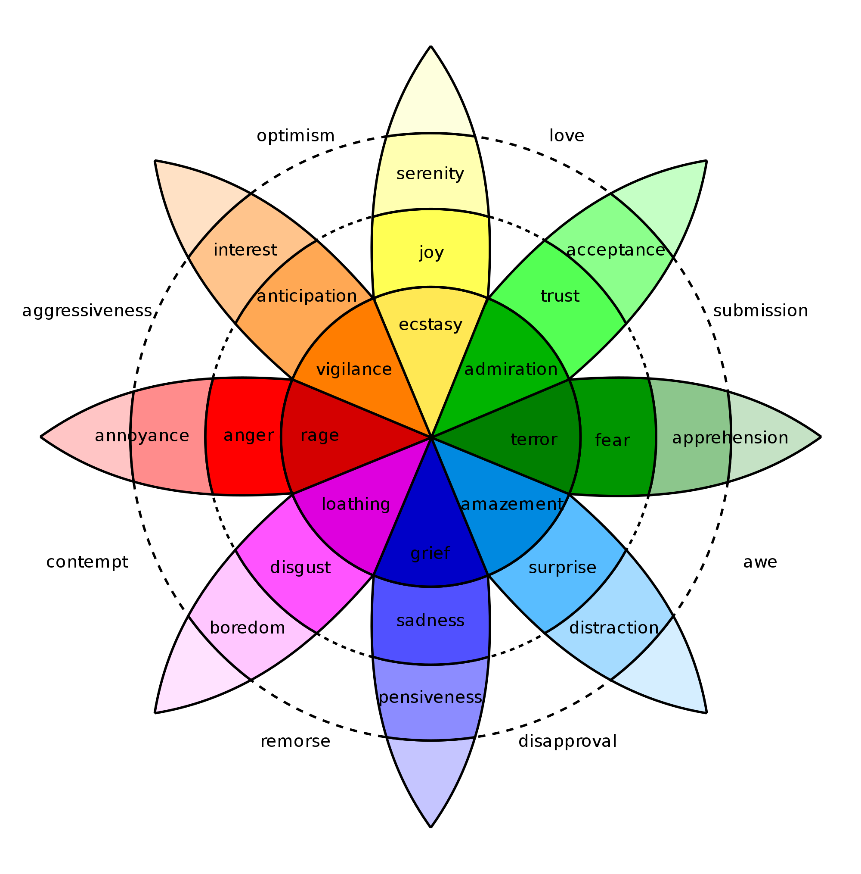
Plutchik’s Theory of Emotions
Notes:
Robert Plutchik claimed that all the emotions we know, are based on 8 main emotions.
The difference between two close emotions is the level of feeling. for example trust and admire.
In addition, emotions can also be mixed,
for example love is a mix of joy and trust
Ok, now we have an emotion model, but how can we analyze emotions?

Slide 4
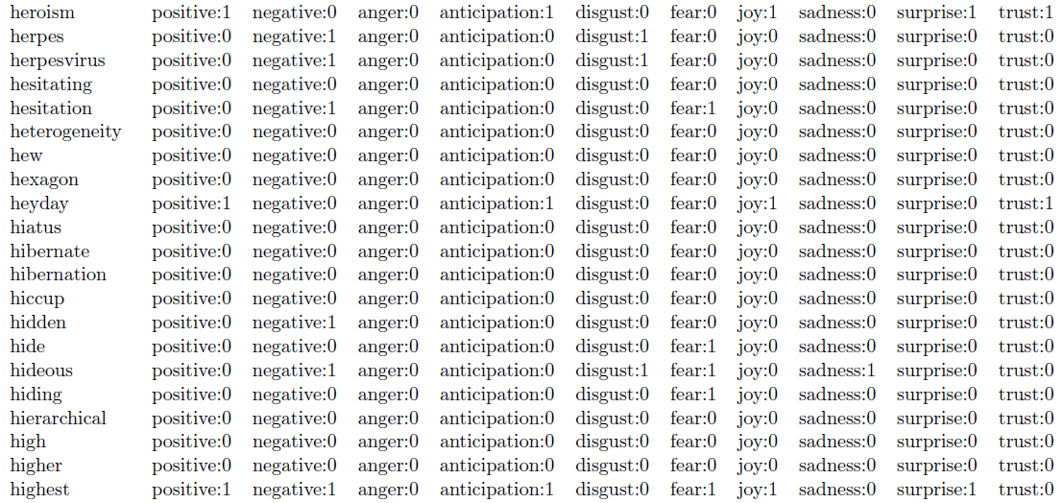
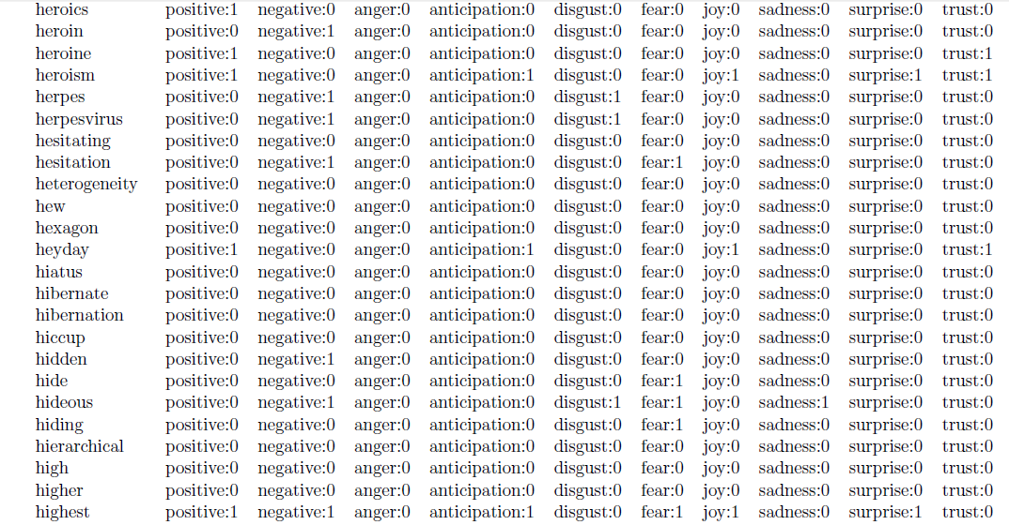
Emotion Analysis
Notes:
Using the NRC lexicon, the emotions can be translated to numbers.
The lexicon connects words to the emotions they reflect, by given them a binary value.
This connection was made by human decision.

Slide 5

Notes:
So after you know what emotions are,
now we talk about where can we express them.
Twitter is a social network that does not filters content
and open for everyone and everything,
even for pornography and violence.
Which means it allows users to express themselves
without restrictions.

Slide 6
Notes:
The only thing we need is a TV series.
We assume that you to know what is the most watched TV series of the past decade.
More than 16 million people watched the last season of Game of Thrones.
We choose this series because it is very dynamic
and full of surprises that arouses our feelings

Slide 7
Linear
Regression
Notes:
In addition, we decide to predict the emotions of new text.
In order to do that, we need a prediction model.
Linear regression is a simple machine learning method that assumes there is a linear relationship between independent variable(s) and dependent variable.
It is used to predict the value of the dependent variable by mathematical process.
We need to provide to the method one or more independent criteria which we believe have a relationship to the value that we want to predict.

Slide 8
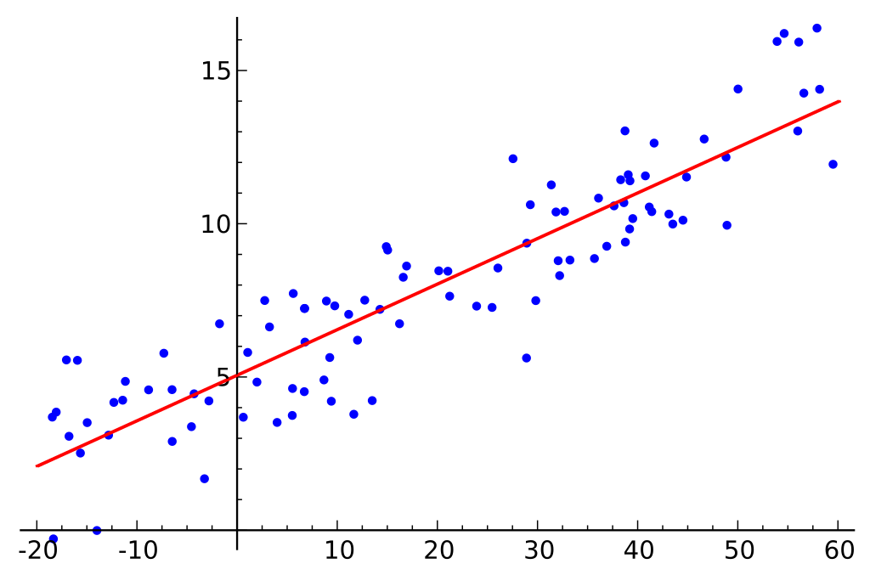
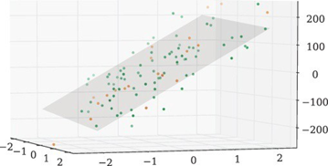
Linear Regression
y=ax+b
y=a1x1+...+anxn+b
Notes:
There are two types of linear regression:
simple linear regression and multiple linear regression.
The different between them is the number of criteria.
for the simple we provide only one criterion, for the multiple more than one. each criterion is an axis. for example:
In the left image, you can see a simple linear regression.
it is a 2-dimension graph. The x axis is the criterion and the y axis is the predicted value.
However, in the right image, you can see a 3D graph. two axises for two criteria and one for the predicted value.
In addition, the linear line (or the hyperplane) determine by the minimum square errors.

Slide 9
The Goal
Notes:
In our project we have 3 main goals:
To analyze the audience’s emotions, from the tweets we have.
Another goal is to predict for new tweets the values of each emotion, using multiple linear regression.
The last goal is to analyze the scripts of the Game of Thrones, and compare them with the audience emotions from the tweets.
How we do that?

Slide 10
Flow of Events
Consolidation
Tweets &
Script-lines
Cleaning
Scoring
Comparison
Prediction
Notes:
We got 3 million tweets that mentioned game of thrones, were posted during the airing of the seventh season.
We also got the scripts of this season.
We grouped all the tweets by the episodes.
A tweet refers to the last aired episode

Slide 11
Cleaning
Group the tweets by episodes
Lowercase, remove punctuation
Translate significant strings
Lemmatization
Omg Arya will
be so happy when Jon gets back to Winterfell with gendry, 2 dragons and Daenerys targaryen :)
oh my god arya will be so happy when jon get back to winterfell with gendry 2 dragon and daenerys targaryen happy
Notes:
Before we could analyze the tweets and script lines, we had to clean them first.

Slide 12
Scoring
 | god | happy | dragon | happy | total | normalized
Joy | 1 | 1 | 1 | 1 | 4 | 1
Trust | 1 | 1 | 1 | 1 | 4 | 1
Fear | 1 | 0 | 1 | 0 | 2 | 0.5
Surprise | 0 | 0 | 1 | 0 | 1 | 0.25
Sadness | 0 | 0 | 0 | 0 | 0 | 0
Disgust | 0 | 0 | 0 | 0 | 0 | 0
Anger | 0 | 0 | 0 | 0 | 0 | 0
Anticipation | 1 | 1 | 1 | 1 | 4 | 1
oh my god arya will be so happy when jon get back to winterfell with gendry 2 dragon and daenerys targaryen happy
Notes:
After cleaning the data, we broke it to words.
To score the tweets and script-lines, we used the NRC lexicon, to score each word separately.
Then we summed the words’ values, and normalized them.
Eventually, we had a vector of emotions for each tweet and script-line

Slide 13
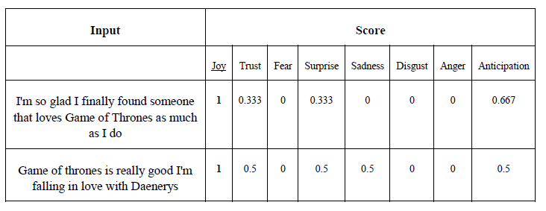
Scoring
How well our system scored?
Example: Joy
Notes:
Here we can see actual scores that our system gave to tweets by the end of the analysis. These tweets express joy, which got the highest score.

Slide 14
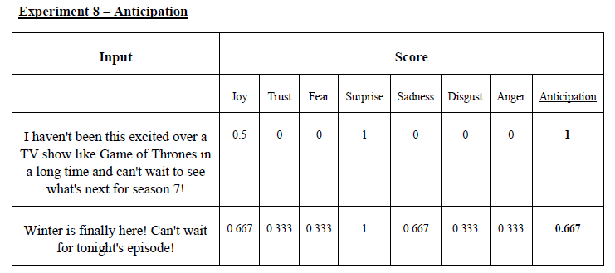
Scoring
How well our system scored?
Example 2: Anticipation
Notes:
That’s another example, of tweets that express anticipation.
These tweets express joy, which got the highest score.

Slide 15
Consolidation
Episode: 3
Category: Character
Character: Jaime Lannister
tweet #1:
game of throne s07e03
good lord what
crazy television
@nikolajcw is a hero
tweet #2:
I feel your pain, Olenna told Jaime that Casterly Rock is worthless, but she didn’t tell daenerys.
I hate sloppy writing
tweet #3:
It didn’t hurt me when jon snow died, but Jaime’s death is going to hurt a lot a lot
Notes:
When the user will insert his parameters, only the relevant data will be summed.
During the summing, we will get two tweets that are close enough to the result.
Finally, we will show the user the relevant analysis result, the prediction and the two tweets that we found in the previous step.

Slide 16
Consolidation
 | #1 | #2 | #3 | total | normalized
Joy | 1 | 0 | 0 | 1 | 0.4
Trust | 1 | 0 | 0 | 1 | 0.4
Fear | 0.5 | 0.667 | 1 | 2.167 | 0.866
Surprise | 1 | 0 | 0.25 | 1.25 | 0.5
Sadness | 0.5 | 1 | 1 | 2.5 | 1
Disgust | 0 | 1 | 0.25 | 1.25 | 0.5
Anger | 0.5 | 0.667 | 0.75 | 1.917 | 0.766
Anticipation | 1 | 0 | 0 | 1 | 0.4
Notes:
When the user will insert his parameters, only the relevant data will be summed.
During the summing, we will get two tweets that are close enough to the result.
Finally, we will show the user the relevant analysis result, the prediction and the two tweets that we found in the previous step.

Slide 17
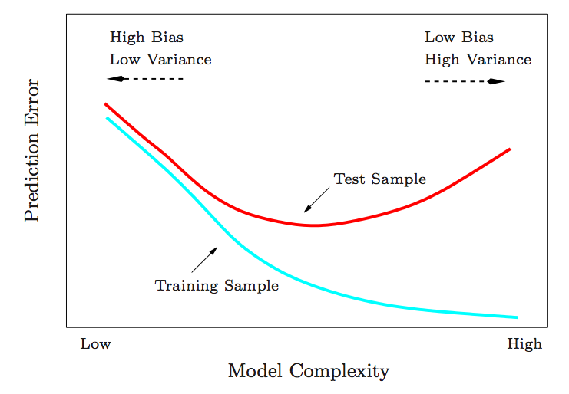
Prediction
A linear regression model for each emotion
The words of the lexicon are the criteria of the models
Each model is built 15 times
The model with the minimum mean square error (MMSE) is chosen
Notes:
A linear regression model for each emotion
The words of the lexicon are the criteria of the models
We build each model 15 times, with changing the minimal requested occurrences for a word to be a criterion
The model with the minimum mean square error (MMSE) is chosen

Slide 18
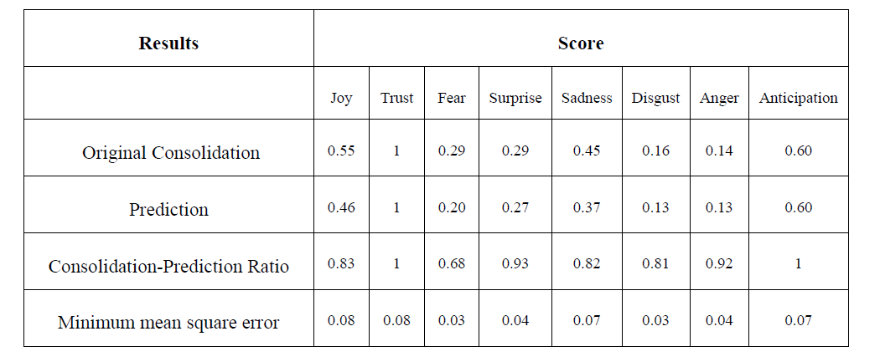
Prediction
How well our system predicted?
Example: episode 2, character, Arya Stark

Slide 19
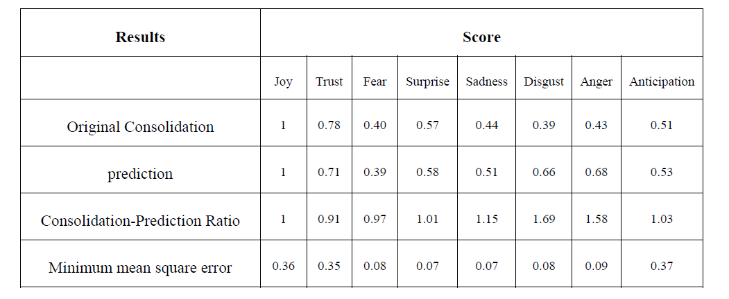
Prediction
How well our system predicted?
Example 2: episode 5, house, Targaryen

Slide 20
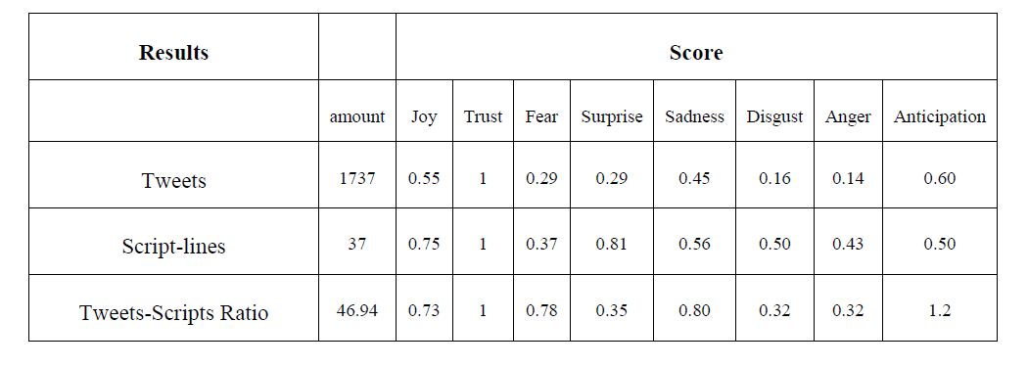
Comparison
Audience opinion VS. scripts:
Example: episode 2, character, Arya Stark

Slide 21
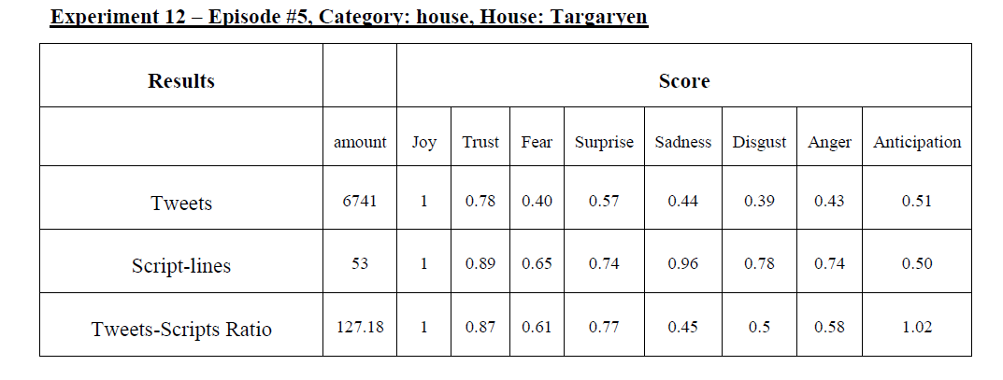
Comparison
Audience opinion VS. scripts:
Example 2: episode 5, house, Targaryen

Slide 22
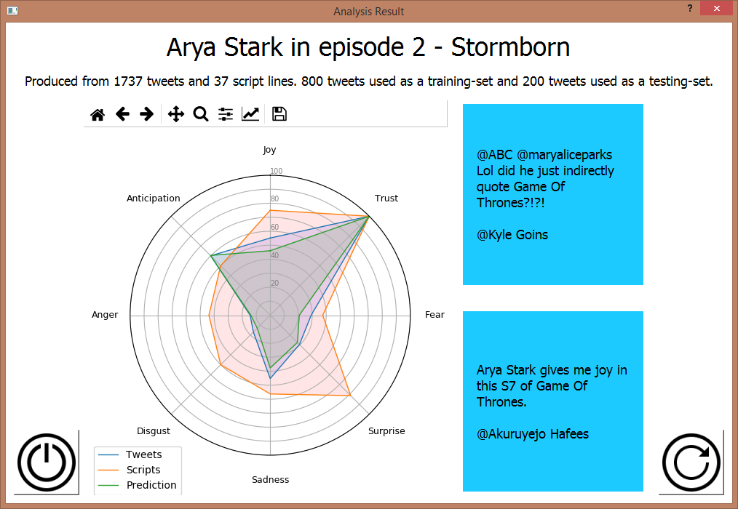

Slide 23
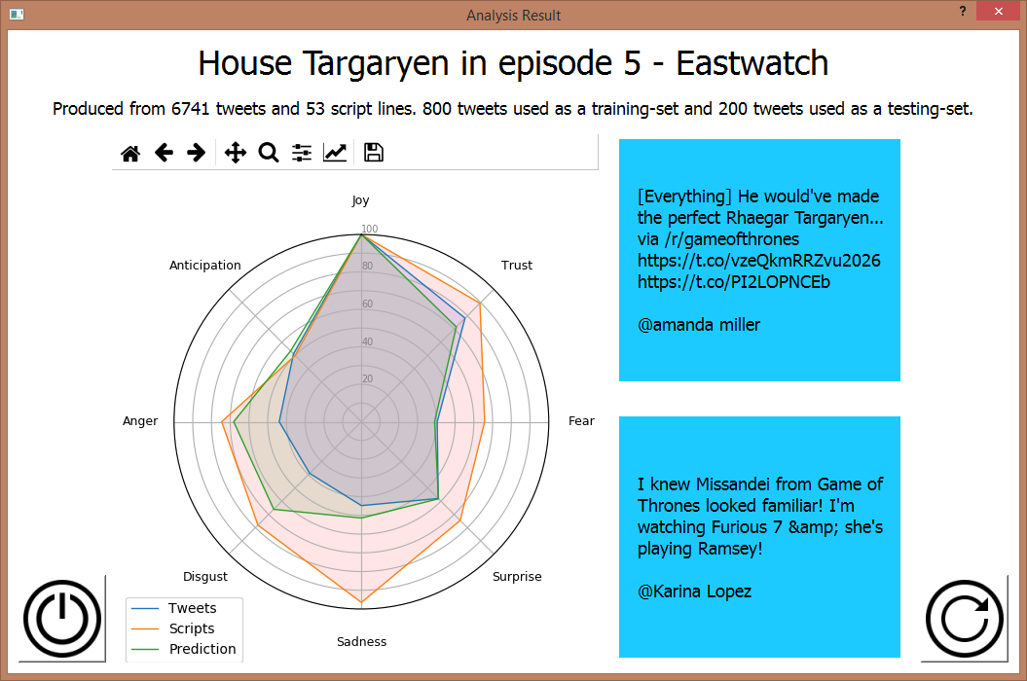

Slide 24
Demonstration
Notes:
Now we gonna show you a demonstration to our algorithm.

Slide 25
Testing plan:
Test ID | Description | Expected result | Actual result
ScoringAnger | Analysis of tweet that contains only one term, and it expresses anger only | The tweet’s emotions scoring vector holds ‘1’ for anger, ‘0’ for other emotions | Pass
TweetsCleaningEmoji | Cleaning of tweet that contains a Unicode of an emoji that appears in the database | Clean form of the tweet contains the emoji’s representative word as appears in the database | Pass
ScriptLineCleaningLematization | Cleaning of script line that contains a word in an inflectional form | Clean form of the script line contains the word in its original lingual form | Pass
LoginNoInput | User clicks on login without input | Login denied | Pass
Notes:
We choose a part of the testing plan to present.
One type of testing is scoring emotions.
for each emotion we tested if the scoring was right.
addition type is cleaning.
In our project we clean tweets and script lines.
We tested if a word convert to it basic form.

Slide 26
Software Engineering Documents

Slide 27
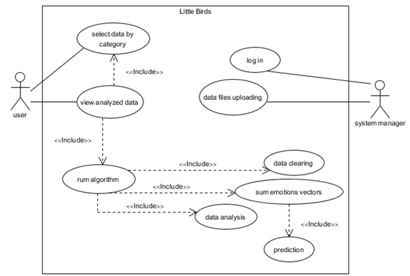
Requirements (Use Case)
Notes:
Our system allows to the manager to upload data file. It will clean and analyze them by the algorithm Rotem presented. In order to do so, a user will need to login first.
The System lets any user choose search parameters. The data is summed accordingly. Then the relevant analyzed data is presented to the user.

Slide 28
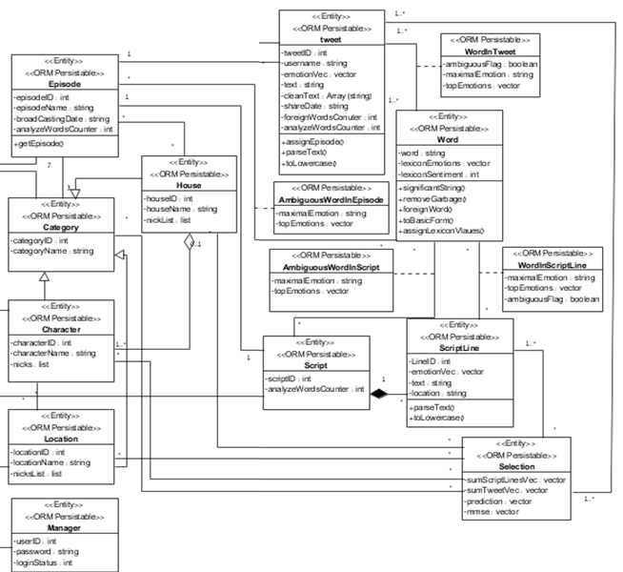
Class
(Entities)
Notes:
These are the entities in the system. We also have others for boundaries and controllers. We don’t have enough time for it all. We can see here the way we save the rank of words, tweets and script-lines.

Slide 29
Thank you for listening!
Notes:
Thank you very much, if you have any questions, ask please

Slide 30
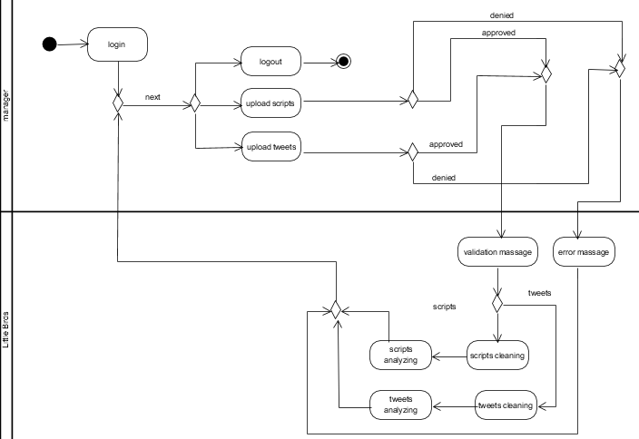
Manager Activity
Notes:
This is the manager functionality in our system.
first the manager have to login to the system which verify that he is actually a manager.
after login, two main options are presented to him: he can either upload data or logout.
The uploaded data can be either scripts or tweets.
If there is a mismatch regarding file types, an error will show.
If there is a match and validation message was shown, the process of cleaning and analysing data starts.

Slide 31
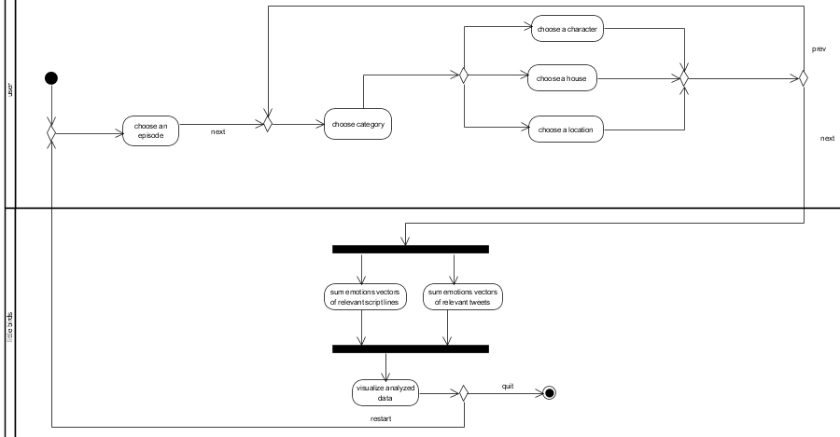
User Activity

Slide 32
